Slide 1


TOPIC – Data Analysis on Netflix Shows
PROJECT OF DATA ANALYSIS AND REPORTING
Submitted To:- Mrs Deepika Tiwari Submitted By:-
Course:-B-Tech CS(DS+AI) kartikeya kumar Agnihotri (202410101150077)
Group:-33 Avinash Mishra (202410101150089)

Slide 2
INTRODUCTION
Dataset : Netflix Shows
Programming Language- Python
Libraries Used(Analysis and visualization) - pandas, matplotlib

Slide 3
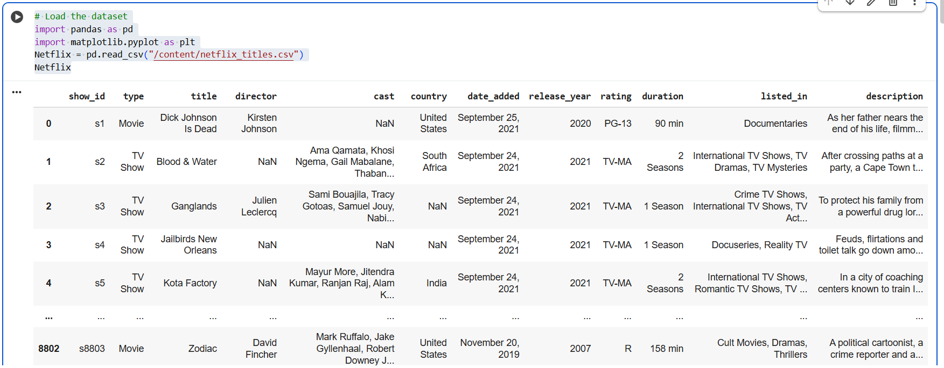
Step 1: load the csv file

Slide 4
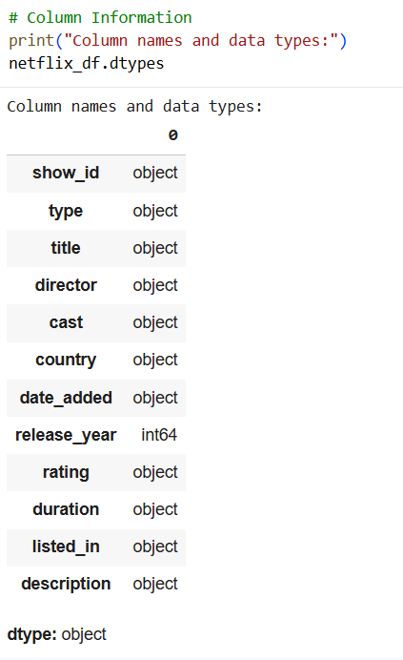
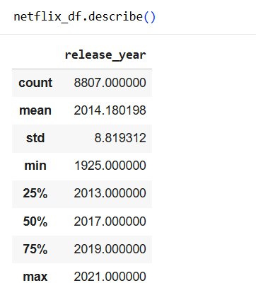
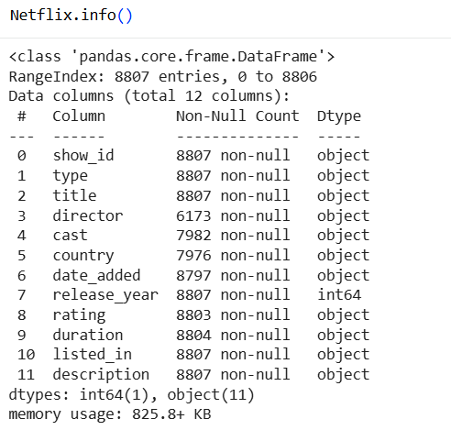
step 2 : Data inspection and exploration

Slide 5

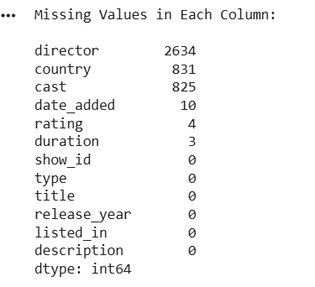
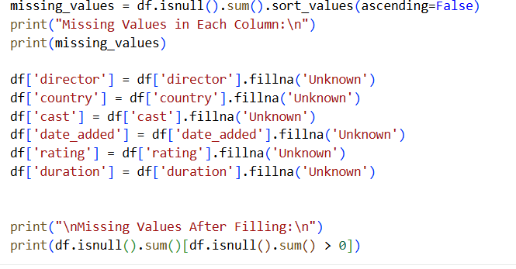
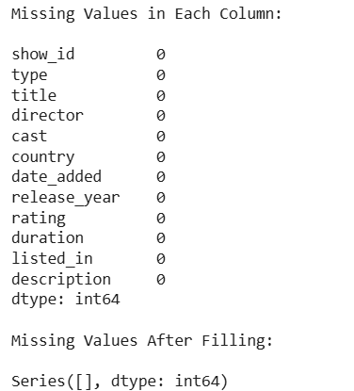
MISSING VALUEs
Step 3

Slide 6

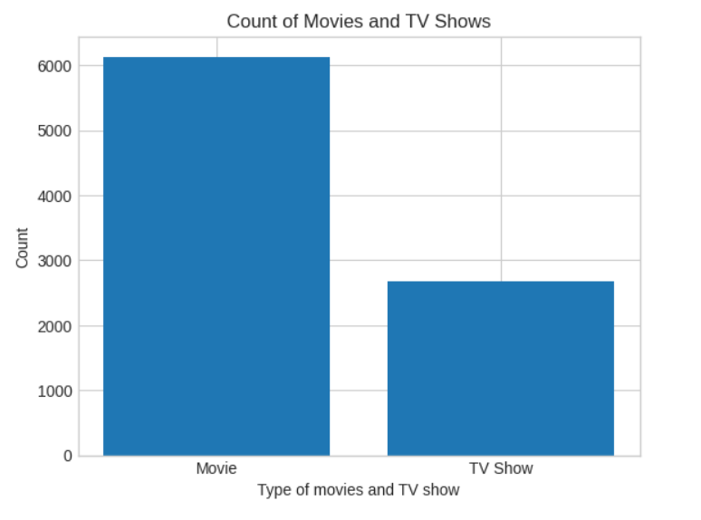
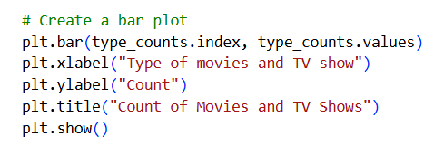
Step 4: Count of Movies vs TV Shows

Slide 7
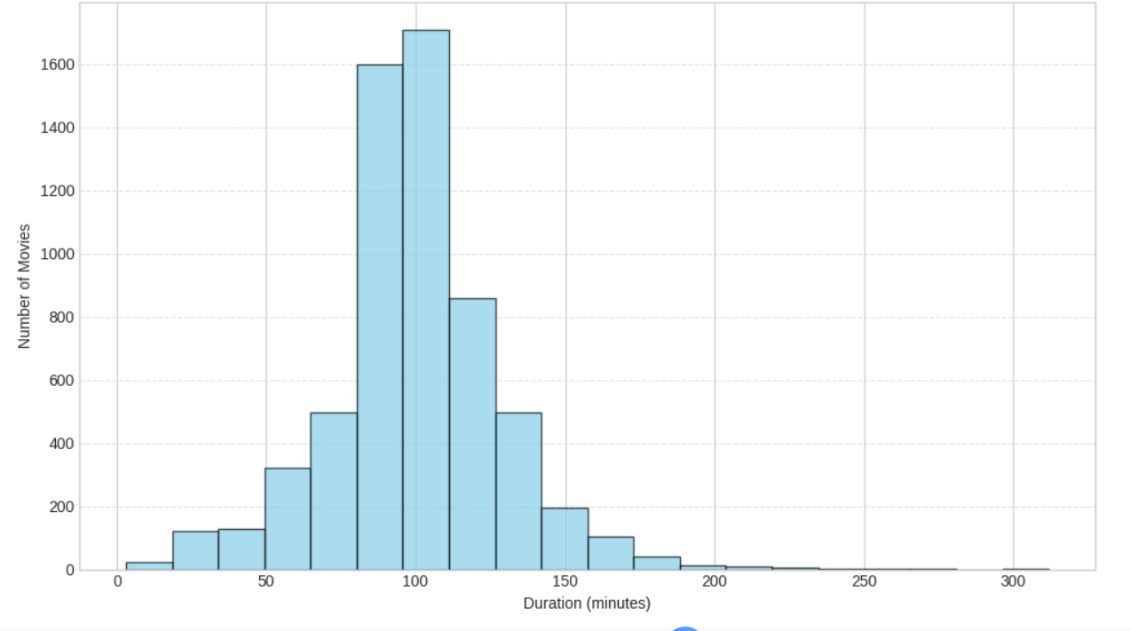
Step 5: Distribution of Movie Durations

Slide 8
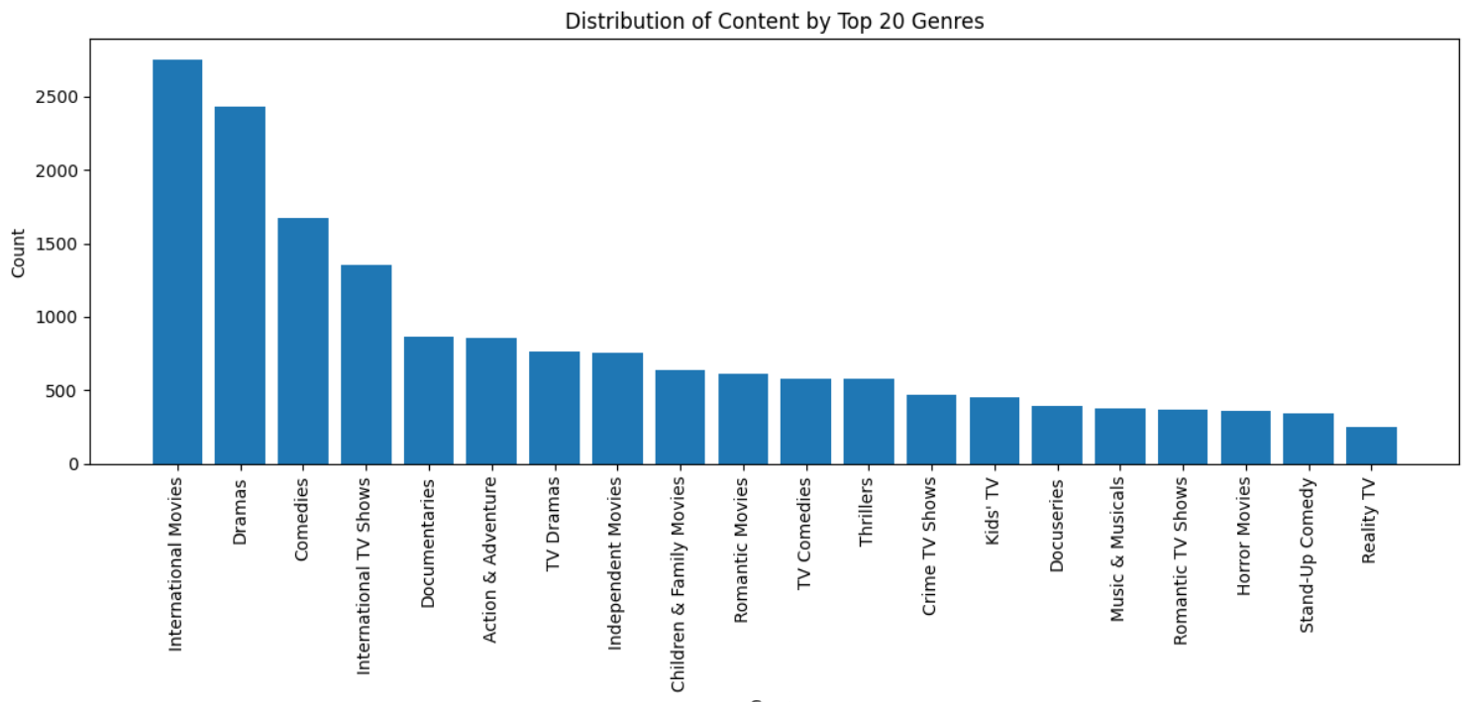
Step 6: Genre and Content Analysis
1. The most common genre on Netflix is “International Movies”, followed by “Dramas” and “Comedies.”
2. Less frequent genres include Stand-Up Comedy, Reality TV, and Horror Movies.

Slide 9
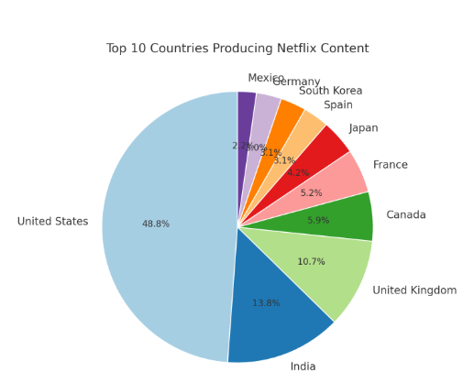
Step 7: Top 10 Countries Producing Netflix Content
1. The United States contributes the largest share of Netflix content.
2. Countries like Japan, South Korea, and Spain have smaller yet noticeable portions — showing regional content diversity.

Slide 10
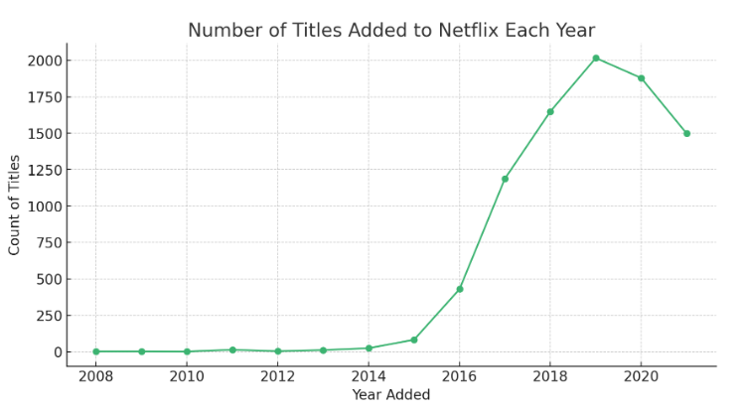
Step 8: Number of Titles Added to Netflix Each Year
Netflix’s content library grew slowly between 2008 and 2014, as it was still expanding globally.
The number of titles added peaked around 2019–2020, showing the platform’s most active growth phase.

Slide 11
Final Insights
The United States produces the most content, followed by India and the United Kingdom, showing Netflix’s strong global footprint.
Rapid growth after 2015 — the number of titles added increased sharply as Netflix expanded into original productions and new markets.
Movie durations typically range from 80–120 minutes, representing standard feature-length films.

